Slide 1
Capstone Project Retail Sales Prediction By Dhanraj A Tiwari Raghavendra Narayana

Slide 2
Deriving insights for the Retail Sales Prediction
1. Understanding the dataset with all rows and columns that what the dataset is trying to say.
2. Cleaning all the data and removing all the null values .
3. And after that process we are doing regression in which we are training and testing our model.
4. Then at last we are checking the accuracy that how much accurate does our model is.

Slide 3
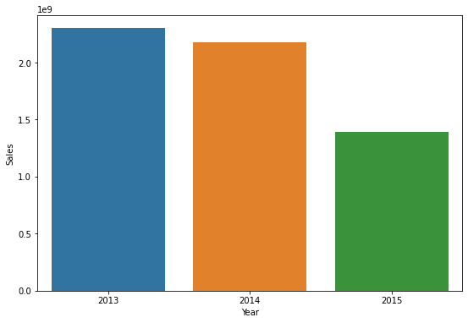
Exploratory Data Analysis
1. At first we are merging two given datasets which is Rossmann and Store from which we can make
predictions.
2. And then we are comparing our dependent column which is ‘Sales’ with the independent column
‘Date’. And further we are subdividing the date column into year,month ,and day.

Slide 4
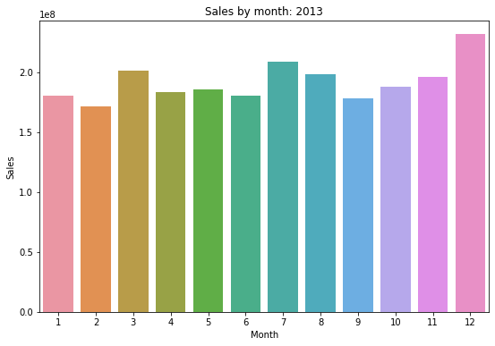
3. There is o/p which we got according to sales and Year column which consists data of
2013,2014,2015.
4. And this o/p is for month sales getting in 2013.

Slide 5
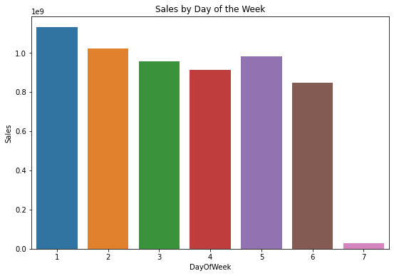
4. And this o/p is for sales happen in weeks.

Slide 6
And also we had many plotings technique(barplot,boxplot, histplot etc.) which can make our dataset more clear.

Slide 7
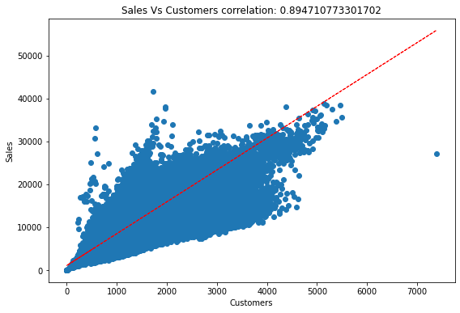
Linear Regression
1. Now we are doing regression with all give independents with dependent variable.
2. We can see here that we only having good correlations between Sales and Customers.

Slide 8
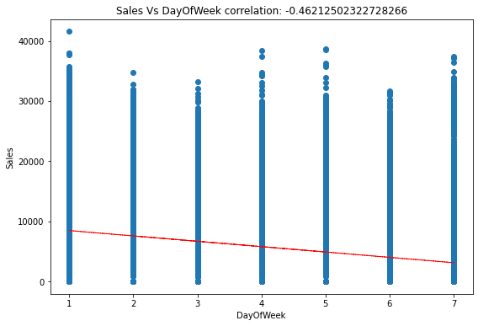
3. And with DayOfWeek we are not having good correlation.

Slide 9
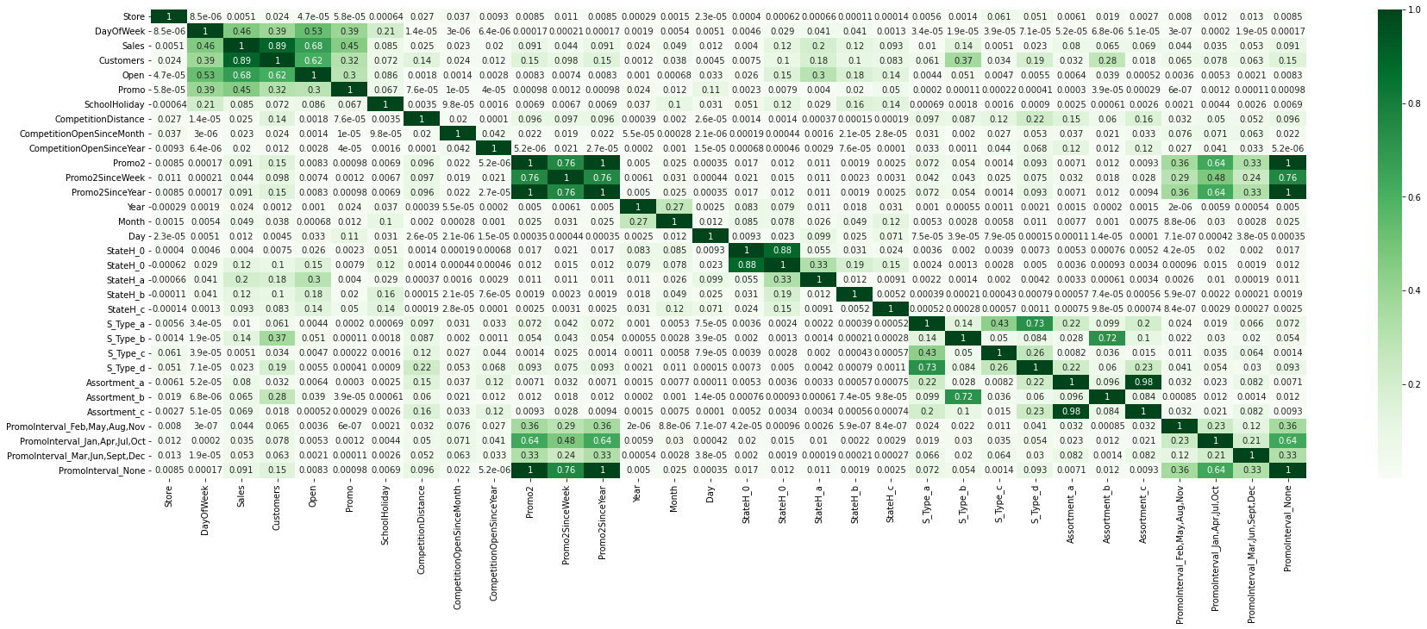
Now we are checking the multicollinearity by heatmap.

Slide 10
Data Preparation
1. We are training and testing our model .
2. After training and testing the model we go for accuracy test.
3. At first we are fitting our model with Linear Regression and checking accuracy
which is giving us an 0.938 which is good accuracy it means that we prepared
our model in better way.
4. We also used Lasso, Ridge for accuracy check it is also around same to .93.

Slide 11
Conclusion
We did eda removed all the unncessary things and done training testing of our model and also done regression and at last accuracy test by using Linear Regression Lasso Ridge ElasticNet and so on which gave us an
accurate model .

Slide 12
References
1.)
http://cs229.stanford.edu/proj2015/215_report.pdf

